Slide 1
Logging
Recording Issues In an application

Slide 2
Introducing Logging
  Logging: Recording messages that occur while a program is executing.
    Message: any sort of text about the program’s execution
  Logging lets us track what’s going on in a program
    What code is running
    What errors have occurred
    The state of the system when the error occurred

Slide 3
Why Log?
  Aids in debugging
    Gives us a snapshot of what was happening in the system (and what led to it) when something broke
  Allows for system monitoring
    Track the system’s health
    Generate performance metrics
    Analyse behaviour
  Enables compliance with auditing requirements
    We can log critical events or other required information, e.g. movement of money, working with sensitive information etc

Slide 4
Logging Libraries
  Java’s built-in logging classes are not actually great…
    They work, but they aren’t the industry standard
  There are two main other logging library options available:
    log4j2 – Updated version of log4j
    logback – Successor to log4j built by Apache
  We will be using logback
    Spring (our web framework) standard for logging

Slide 5
Introducing logback
  One of the most widely used libraries for logging in Java is logback
    This is an external dependency and must be added to your POM
      Not necessary in Spring – it is bundled in spring-boot-starter-web
    Automatically compatible with SLF4J – Simple Logging Façade for Java
  Main components:
    Log levels – Standard levels used to indicate the severity of a message.
    Loggers – Logging objects; used to log messages
    Appenders – Used to define the destination of logs – can be linked to the console, a file, a network socket, a database etc
    Log format – Define the structure and layout of log messages
  Useful logback tutorial: https://www.baeldung.com/logback

Slide 6
Logback POM dependency
<!-- https://mvnrepository.com/artifact/ch.qos.logback/logback-classic -->
<dependency>
<groupId>ch.qos.logback</groupId>
<artifactId>logback-classic</artifactId>
<version>1.5.18</version>
<scope>compile</scope>
</dependency>
Not needed if you use Spring, as Spring’s dependencies already contain this!

Slide 7
Logging Levels
  Log levels indicate the relative importance of a message
    This will allow us to filter log messages based on the situation
  5 main levels included in Java logging libraries
    FATAL – System cannot recover, might have incurred data loss/corruption
    ERROR – Something has gone wrong, but it can be recovered from with user/admin intervention
    WARN – Something has gone wrong, but it’s automatically recoverable (the default level)
    INFO – Informational messages, useful for status updates, service start/stops etc
    DEBUG – Messages to be used when debugging
    TRACE – Used to log extremely detailed information. Ideal for tracing the application's internal workings (similar to debug but more granular).
SEVERITY

Slide 8
Choosing Logging Levels
Note the process vs program distinction here!
Are you logging to record variable states?
Is the log for an unwanted situation?
Can the process keep going beyond this?
Can the overall program keep going beyond this?
NO
YES
NO
NO
FATAL
YES
YES/NO
YES
YES
DEBUG
INFO
WARN
ERROR
Notes:
Trace isn’t in here as generally trace is only needed when you can’t get enough information from debug. For trace, you are basically tracing through every single step to understand what’s going on within the code. This goes down as far as logging on entering and exiting a method.

Slide 9
Loggers
  Logger: An object used to log messages.
    Syntax to create a logger: logger_name = logging.getLogger(ClassName.class)
  Each message is logged at a specific level.
    Syntax: loggername.level(“Message to be logged”)
  Logger is set to automatically filter messages based on a specific level
    Only messages logged at or above this level will be displayed
    Default filter level is warn
  All messages for a given logger go to the same destination.
    Default is to the console.

Slide 10
Logger Functionality
  The most common actions carried out with loggers are:
    Configuring the logger for use
    Logging a message
  You can log messages without configuring a logger
    Default settings will be used instead
      Default destination: the command line/shell
      Default log level: Ignore all log messages below warning

Slide 11
Logging Messages
  The methods to log issues are very conveniently named after the various log levels:
    trace(message)
    debug(message)
    info(message)
    warning(message)
    error(message)
    fatal(message)
  One other (very useful) option: error(message, Throwable)
    Logs an error-level issue marked with the supplied message
    Logs the exception (a Throwable) that occurred, including its stacktrace
The message included here will be logged in a specific format defined at configuration

Slide 12
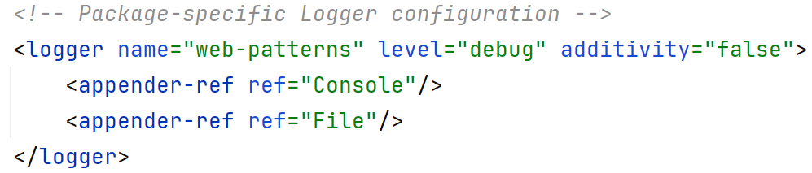
Configuring a Logger
  Logger configuration can be done using an XML config file
    Can also be done in code, but must rebuild project to change settings
  Loggers are configured by specifying:
    name: The name of the package for which the logger is responsible
    level: The level at which the logger will log
    additivity: Whether the logger should inherit behaviour from any parent loggers
    appender-ref: Appender to handle the destinations for this logger’s logs
Example found in src/main/resources/logback.xml

Slide 13
Log Appenders
  Log appenders control:
    Where the log messages should be written to
    How the log messages look
  Main appender tags:
    appender – Overall tag defining appender. Defines the name of the appender and the type
    encoder – Defines the encoder to be used
    pattern – Subtag of encoder. Defines the pattern to be used by the encoder
    file – Defines the destination file

Slide 14
Building & Configuring Appenders
  When configuring your logger, you can specify several appenders to allow logs to go to multiple destinations
  Each appender would be created as a specific appender type
    E.g. Appenders linked to files would be defined as File appenders
  Each appender can be configured in its own way
    Can set different formats
    Can set different policies
Sample log config file: src/main/resources/logback.xml

Slide 15
Appender Types
  Console: append logs to console output
    class=“ch.qos.logback.core.ConsoleAppender”
    No need to specify a destination!
  File: append logs to a specified file
    class=“ch.qos.logback.core.FileAppender”
    Specify destination using <file> tags
  RollingFile: Log file rolls over when time/size requirement is reached (e.g. daily, over 10mb etc)
    class=“ch.qos.logback.core.rolling.RollingFileAppender”

Slide 16
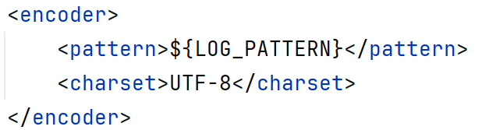
Appender Tag Structure & Properties:
All Appender Types
  appender tag properties:
    name=“Name of appender”
    class=“ClassType of appender”
    Example:
  encoder tag properties:
    <pattern>“Format for log message”</pattern>
    <charset>NameOfCharSet</charset> (not always included)
    Example:
appender is the root tag for all appender configuration tags
Sample log config file: src/main/resources/logback.xml
Config variable!

Slide 17
Formatting Log Messages
  Log messages can be formatted in the properties tag of the logging xml file
    Can also specify colouring!
  Log message format can include certain predefined elements, e.g.:
Attribute | Format Specification | Description
d | %d{pattern} | The time and date, formatted in the specified pattern.
level | %level | The level of the log
message | %msg | The message to be logged.
caller | %caller | The name of the method and class, and the line number on which the log was called.
logger | %logger | The name of the logger used to write the log.
Notes:
Full list of possible inclusions for logback: https://logback.qos.ch/manual/layouts.html#conversionWord

Slide 18
Breaking Down a Sample
Message Pattern
  Pattern:
  %blue(%d{yyyy-MM-dd HH:mm:ss}) %boldRed(%-5level) %logger{36} - %msg%n“
  Explanation:
    %blue() : Display the content of the brackets in blue
    %d : Include the date
    {yyyy-MM-dd HH:mm:ss} : Format the date as:
    year-month(in years)-date hours(24 clock):minutes:seconds
    %boldRed() : Display the content of the brackets in red and in bold
    %level : Include the level of the error message
    (-5 ensures it will always be padded to 5 characters)
    %logger{36} : Include the first 35 characters of the name of the logger.
    %msg : Include the message of the log
    %n : Include a new line call to finish the message display
Example found in -> src/main/resources/logback.xml

Slide 19
Side Note: Defining Config Variables
  There are several situations where text repeats in a config, e.g.:
    File path
    File name
    Log pattern
  We can store these in variables by defining them as properties:
    property name=“VariableName”, value=“Value of the Variable”/>, e.g.:
  These config variables can be accessed using ${}, e.g.:

Slide 20
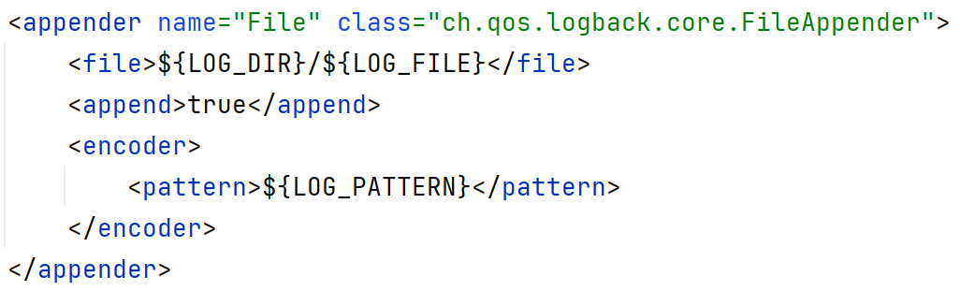
File Appender-Specific Tag Properties
  file – Specifies path and file name
    Often uses configuration file property variables
  append – Specifies if the log file should be appended to or overwritten on application start-up
pattern is another place where variables are frequently used

Slide 21
Security Considerations in Logging
  If done improperly, logging can pose serious security risks
    Example: Github and Twitter both logged plaintext passwords!
  To mitigate risk, we can:
    Avoid logging sensitive information where you can
    Sanitise your log data where you can’t – remove/obfuscate sensitive info, consider masking components
    Encrypt log transmission
    Include security logging (audits to track failed logins, changes in permissions, accessing of sensitive data etc)
    Use secure logging destinations with appropriate access controls
    Securely store/destroy old logs
Notes:
Reference: https://mike-sheward.medium.com/passwords-in-logs-why-what-and-how-8ab7a6d18db6

Slide 22
Logging Best Practices
  Write meaningful log messages – include appropriate information.
  Mark all messages with appropriate log levels.
  Configure logging settings when the application starts – don’t wait!
  Include logging in your error handling.
    Do this for all critical sections of code.
  Avoid logging sensitive information or credentials.

Slide 23
Debugging with Logging
  Log messages can help with debugging
    A more sophisticated version of adding print statements to your code
  Messages like this should be marked as DEBUG level
    They will only display if the logger is set to the most sensitive level
  This type of log call often includes:
    Values from variables
    The function being called
    Where you are in the function
  Include stack traces and exceptions where applicable
    You can log an exception and its stack trace using
    logger_name.error(message, exception)

Slide 24
Logging in Testing
  Logging can provide a concise view on program execution
    This applies to test execution, too!
  Employing logging in tests allows you to easily capture:
    Test output
    Assertions being made
    Test case results
  This gives a report that can be stored as part of the development process
    The filterable nature of logs means you can increase or decrease the amount of information seen from your test reports as needed.

Slide 25
Logging in Production Environments
  Logging in production environments involves some specific considerations:
    How to consolidate logs in a distributed system
      Consider tools like elasticsearch to manage centralising logs
    How to manage log build-up
      Rotate log files based on a specific schedule, a size limit or some other strategy – rolling file
      Define how long a log file should be retained (this may be dictated by compliance requirements)
    How to mitigate performance impact
      Consider asynchronous & buffered logging to allow spread of load and reduce latency
    How to scale to meet increasing requirements
      Design scalable infrastructure and build in redundancies – failovers and load balancers!

Slide 26
Logging in Distributed Systems
  Distributed systems are those where various components are running on separate machines
    E.g. web service running in one place, client in another
  This is a complicated process!
    There are multiple separate parts, but the logs are all interlinked and need to be brought together
    Large systems with many pieces can generate a high volume of logs – the procedures for combining and storing need to scale
    Distributed systems need extra consideration about fault tolerance
    Logging across a network will incur a performance hit

